Slide 1
Virtual-Memory Management
Benefits of Virtual Memory
Demand Paging
Principle of Working-set Model
Shared memory and Memory-mapped files
How to manage Kernel memory

Slide 2

Other Considerations
Advantages of larger page size
Results in smaller page table
I/O time is minimized
Larger page size minimizes page faults
Relationship between page size and sector size on the paging device is also important
Current trend in architecture is to have a relatively larger page size
TLB Reach
Hit ratio of a TLB increases with the increase in the number of entries in the TLB
TLB reach refers to the amount of memory accessible by the TLB
Number of entries multiplied by the page size

Slide 3
Other Considerations
TLB reach can be doubled by doubling the entries in the TLB
Page size increase also increases the TLB reach
Results in greater internal fragmentation
An operating system may provide several different page sizes to suit the varying requirements
Requires the OS to manage the TLB
A bit in the TLB entry indicates the page size
Software managed TLB - Performance loss
Recent trends indicate a move towards software managed TLBs with multiple page sizes

Slide 4
Other considerations
Inverted Page Tables
Use of inverted page table reduces the amount of memory required for per-process page tables
Complete information about the logical address space of a process is not present in the inverted page table
External page tables, one per process, must be kept for the required additional information
External page tables are required only when a page fault occurs
They do not need to be available quickly
A page fault may now cause another page fault
Needs to be handled carefully

Slide 5

Process Synchronization
Synchronization Tools
Synchronization Examples

Slide 6
Synchronization Tools Chapter 6
The Critical Section Problem
Race Conditions
Synchronization Hardware
ISA Support
Semaphores

Slide 7
Process Coordination
A cooperating process is one that can affect or be affected by other processes executing in the system
Cooperating processes can either
Directly share a logical address space or
Are allowed to share data only through shared memory or message passing
Concurrent access to shared data may result in data inconsistency
Explore various mechanisms to handle synchronization issues
Maintain data consistency

Slide 8
Synchronization - Objectives
Present Critical Section problem
Solutions are used to preserve data consistency
Hardware and software solutions of the critical section problem
Memory barriers, Atomic operations
Tools to solve process synchronization problems
Mutex locks, Semaphores, Monitors, etc.

Slide 9
Overview
Cooperating processes and shared data
Critical section problem
Semaphores for mutual exclusion
Hardware support
Barriers
Compare-and-swap operation
Atomic variables
Mutex locks, semaphores, monitors, etc.
Evaluate tools that solve critical-section problem

Slide 10
Background
Provide mechanisms to maintain shared data consistency between cooperating processes
Problem
Bounded buffer producer-consumer problem with a modification of adding a variable count
Count is initialized to zero
Count is incremented with the addition of a new item in the buffer
It is decremented every time we remove an item from the buffer
Both routines are correct separately but may not give correct result if they execute concurrently
Value of count may be incorrect

Slide 11
Modified Code for the Producer Process
while (true)
{
/* produce an item and put in next_produced */
while (count == BUFFER_SIZE)
; /* do nothing */
buffer [in] = next_produced;
in = (in + 1) % BUFFER_SIZE;
count++;
}
Notes:
11

Slide 12
Modified Code for the Consumer Process
while (true) {
while (count== 0)
; /* do nothing */
next_consumed = buffer[out];
out = (out + 1) % BUFFER_SIZE;
count--;
/* consume the item in next_consumed */
}
Notes:
12

Slide 13
Race Condition
count++ can be implemented as
register₁ = count
register₁ = register₁ + 1
count = register₁
count-- can be implemented as
register₂ = count register₂ = register₂ - 1 count = register₂
Notes:
13

Slide 14
Race Condition
One of the interleaving of the count manipulation functions
T0: producer execute
register1 = count {register1 = 5}
T1: producer execute
register1 = register1 + 1 {register1 = 6}
T2: consumer execute
register2 = count {register2 = 5}
T3: consumer execute
register2 = register2 - 1 {register2 = 4}
T4: producer execute
count = register1 {counter = 6}
T5: consumer execute
count = register2 {counter = 4}

Slide 15
Synchronization of Processes
When both processes are allowed to manipulate the shared variable concurrently, incorrect values may result
Race condition
Ensure that only one process is allowed to manipulate a shared variable at any time
Processes need to synchronize in some manner
Such situations occur very frequently in operating systems
Process synchronization
Process coordination

Slide 16
The Critical-Section Problem
Consider a set of processes {P₀, P₁,…., P_{n-1}}
Each process consists of a segment of code called a critical section, where the process may be accessing data which it is sharing with at least one other process and is either
Changing common variables
Updating a common table
Writing to a shared file
Requirement
No two processes should be executing their critical section at the same time
Critical section problem
Design a protocol that the processes can use to cooperate by requesting permission to enter the CS

Slide 17
The Critical-Section Problem
Entry section
Section of code implementing the request
Exit section
Code that follows the critical section code
Remainder section
The remaining code
General structure of a typical process P_{i}
Solution to the critical section problem must fulfill the following requirements
1. Mutual exclusion
If process P_{i} is executing in its CS
No other process can execute in their CS
2. Progress
If no process is executing in the CS, and some processes wish to enter CS, then

Slide 18
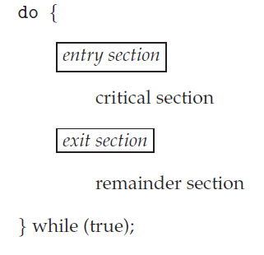
General Structure of a Typical Process

Slide 19
The Critical-Section Problem
Select one of the waiting processes
Selection is made from among the processes that are not in their remainder section
This selection is not postponed indefinitely
3. Bounded waiting
There exists a bound on the number of times that other processes are allowed to enter their CSs after a process has made a request to enter its CS and before that request is granted
Each process is executing at a non-zero speed
Many instances of kernel code manipulating data structures may also suffer from race conditions
Two approaches are used to handle CS in OS

Slide 20
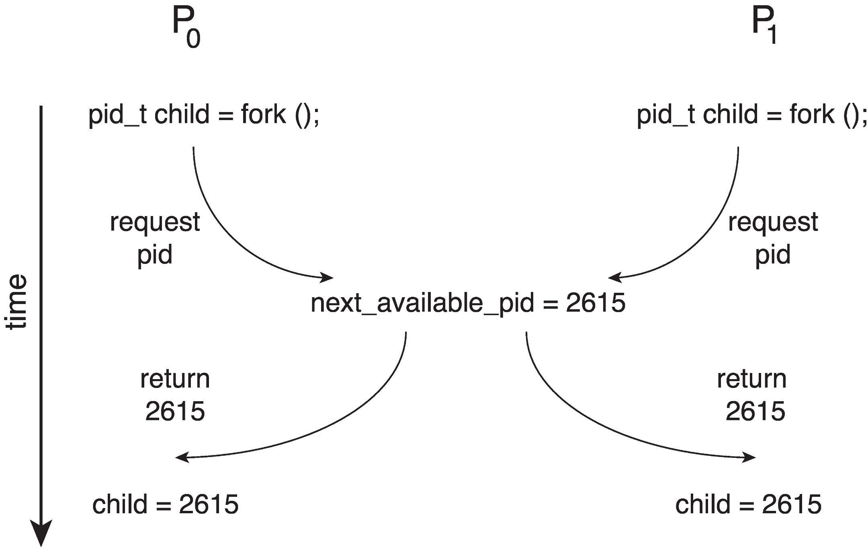
Race Condition when Assigning a PID

Slide 21
The Critical-Section Problem
Preemptive Kernels
Allows a process to be preempted while it is running in kernel mode
May be more responsive
May suffer from race conditions
Needs to be designed carefully (SMPs)
More suitable for real-time programming
2. Nonpreemptive kernels
Does not allow a process to be preempted while it is running in kernel mode
Free from race conditions
Preemptive kernel are more difficult to design and implement
How to manage preemption in kernel?

Slide 22
Peterson’s Solution
A software-based solution to critical section problem
Algorithm is restricted to two processes that alternate to enter and use the CS
Algorithm may not work for current systems
Instructions may be reordered to improve performance by either the compiler and/or the processor
Two data items are shared between the two processes
int turn;
Variable to indicate whose turn it is to enter the CS
boolean flag[2];
An array to indicate whether a process is ready to enter the CS
Working of the algorithm

Slide 23
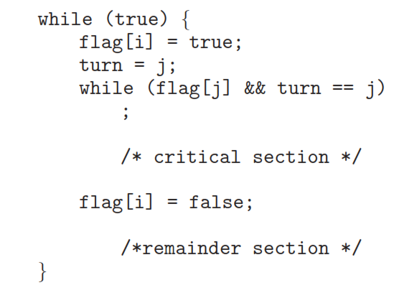
Algorithm for Process P_{i}
Notes:
23

Slide 24
Peterson’s Solution
Prove that the solution meets all three requirements
Mutual exclusion is preserved
P_{i} enters the critical section only if
Flag[j] == false or turn == i
Both processes execute in the CS only if
flag[i] == flag[j] == true
Value of turn would allow only one process to enter CS
The progress requirement is satisfied
The bounded-waiting requirement is met
P_{i} will enter the CS (progress) after at most one entry by P_{j} (bounded waiting)

Slide 25
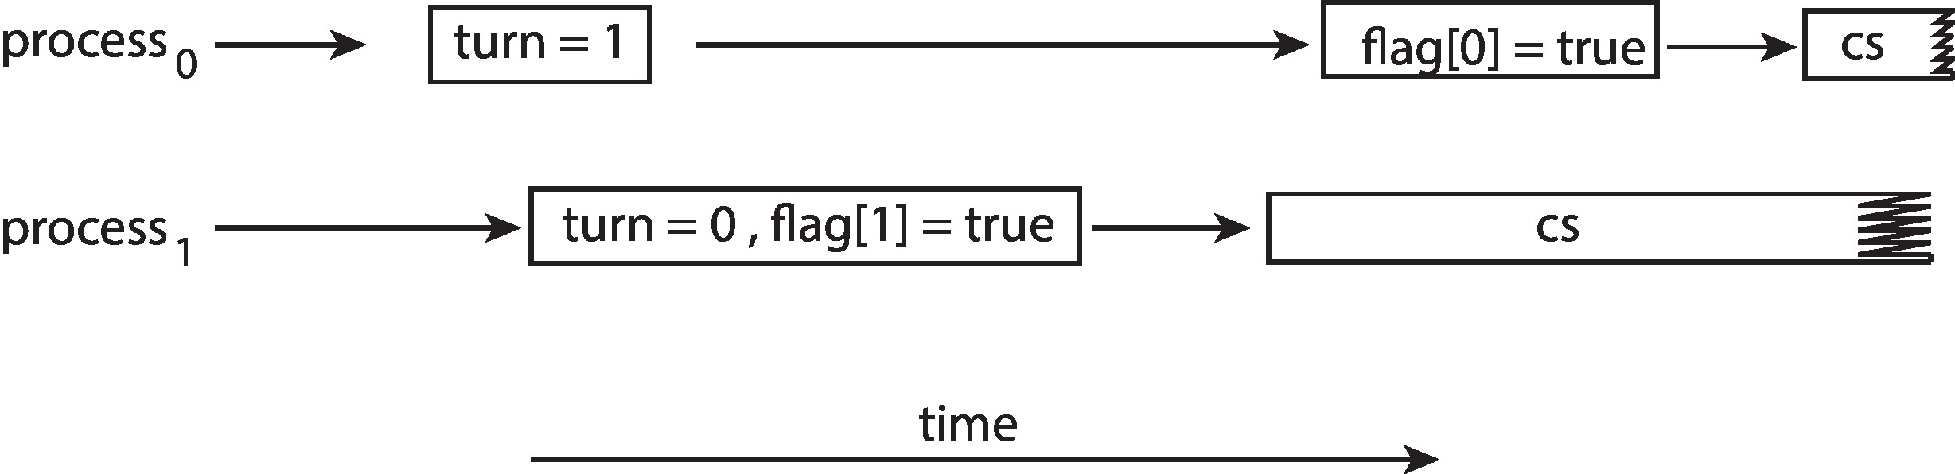
The Effect of Instruction Reordering in Peterson’s Solution

